Slide 1

Breweries In USA
Breweries In the USA
Brief Description of our Project
Analysis

Slide 2
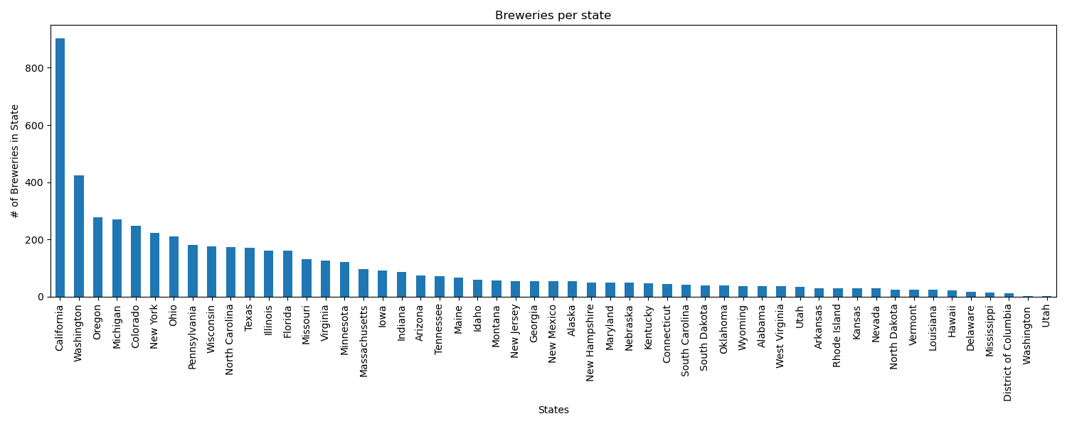
Number of Breweries per State
Looking at the data, there were more breweries, and brewery types, then originally thought by myself. We brought in over 8000 per openbrewerydb and then removed all other countries bringing the total to 5736. Some of the data didn't have Lat/long so those were removed to bring the dataset to 5524 breweries. California leaded the most with this dataset with 904 with second being Washington at 423.
When the data was mapped, it appears that majority of the breweries are near a body of water. Either being on a coast or near a large lake body. Import/Exports would have been the next step to look for and compare with ports and brewery locations, but unable to find necessary data in timeframe.

Slide 3
Number of Breweries per State
Right off the bat, we can see that there is going to be an outlier in California. The # of breweries is drastically higher than almost all of the other states equaling 4, even 5 times the amount.

Slide 4
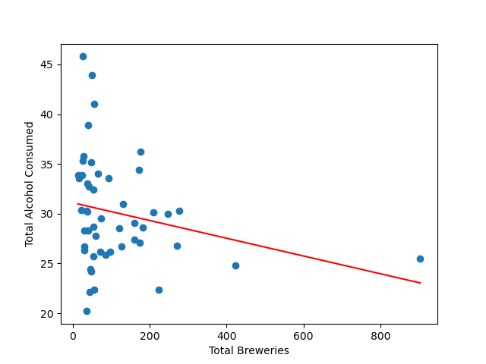
Consumption Rate to Number of Breweries
While alcohol consumed by state is a little closer together. Although, a number of our highest producing states of breweries have actually some of the lowest #s of alcohol consumed when comparing inside our DF.

Slide 5
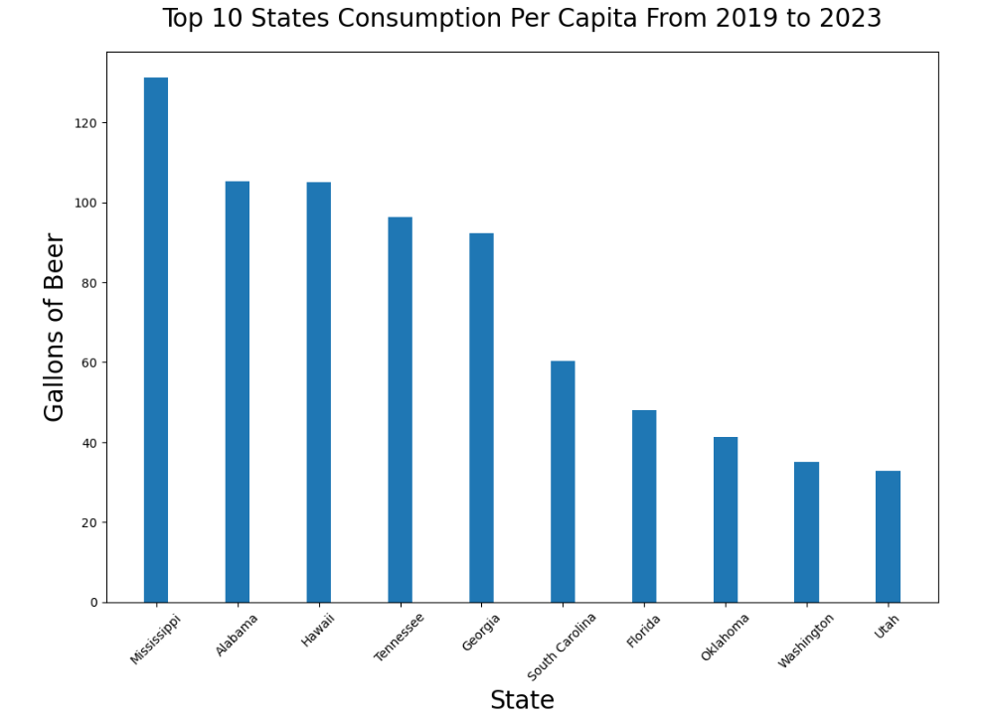
Consumption Rate to Number of Breweries

Slide 6
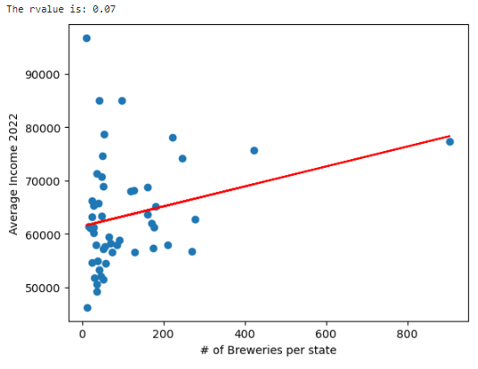
Average Income to Number of Breweries
Brief Analysis

Slide 7
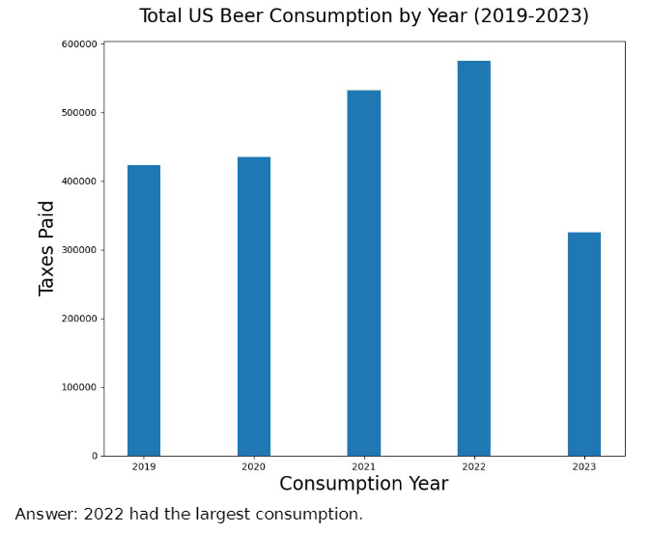
Between 2019 and 2023, which
year had the highest
consumption?
2022 had the largest consumption.

Slide 8
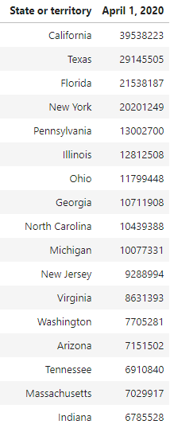

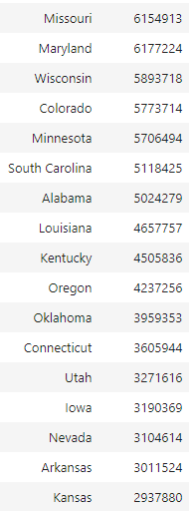
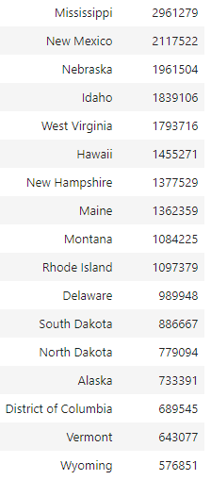
Population of each State
The population of Alaska is greater than Washington D.C. (District of Columbia), Vermont, and Wyoming respectively. If you were to rank Kansas by its bordering states according to the 2020 census data, the rankings would go:
Missouri first with a population of 6,154,913, Colorado with a population of 5,773,714, Oklahoma with a population of 3,959,353, Kansas with a population of 2,937,880 then, Nebraska with a population of 1,961,504, in that order.
Every state within the Top 10 of population size is touching a body of water: California, Texas, Florida, New York, Pennsylvania, Illinois, Ohio, Georgia, North Carolina, and Michigan all touch a major body of water.

Slide 9
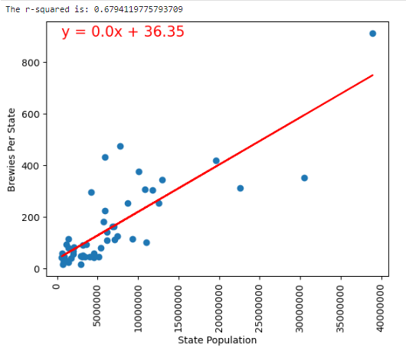
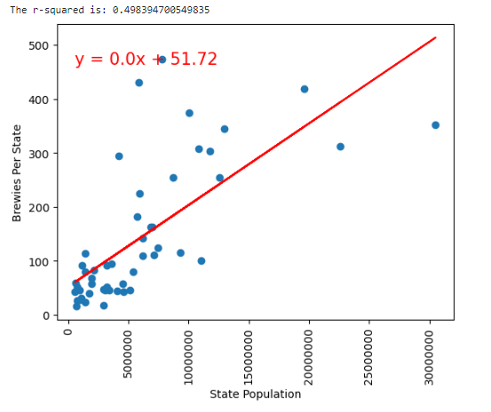
State Population to Number of Breweries
With all the states and territories there is a moderate correlation between the state population to the number of breweries with the r value equaling about .68
California is an outlier with 912 Breweries to the population when we remove it the r value becomes about .50

Slide 10
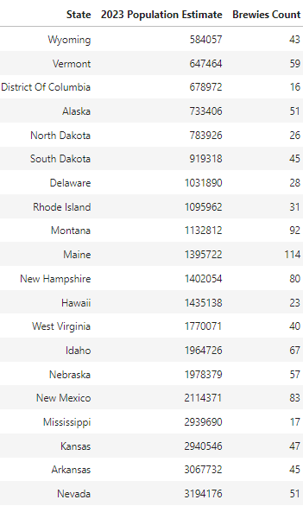
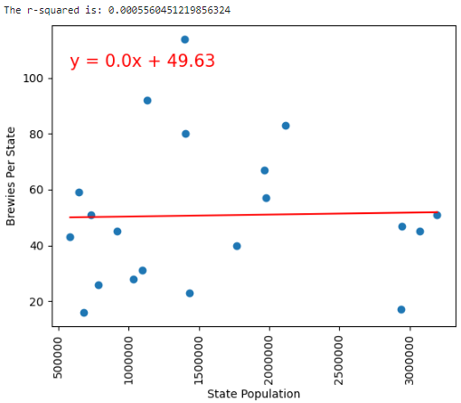
State Population to Number of Breweries
If we did just the 20 smallest states there would be no correlation even with the 114 breweries in Maine. Even Nevada with its population the brewery count is 51.

